Slide 1



CULTURE SPOT 3;
American values

Slide 2
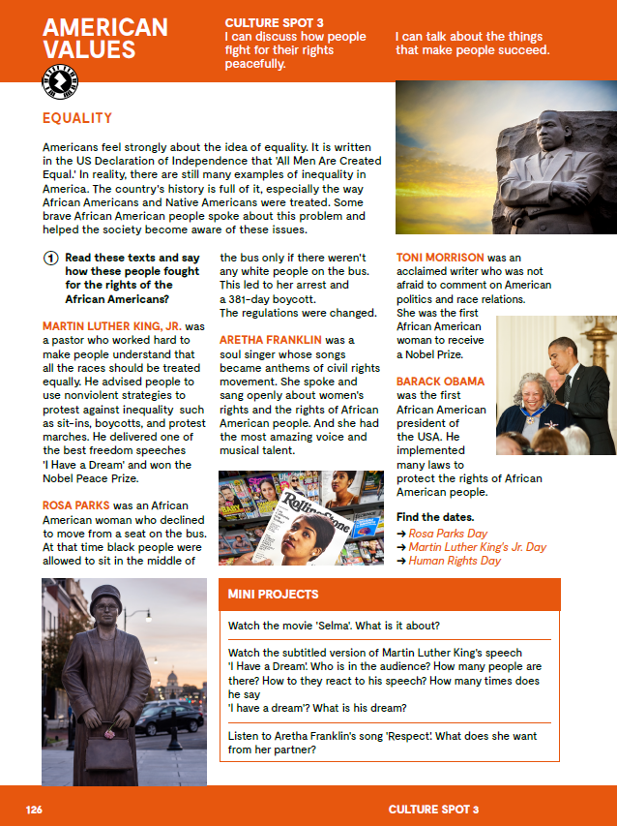
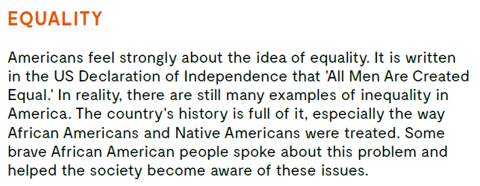
What does the word EQUALITY mean?
Think of the examples of inequality in everyday life.

Slide 3

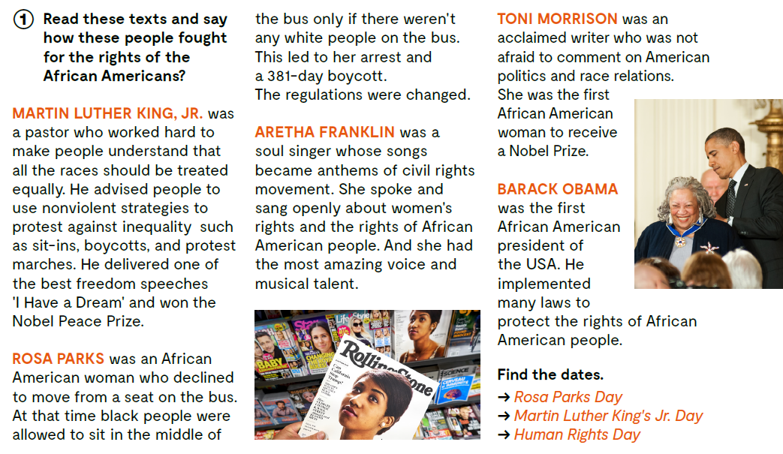
.
Find the dates.
Rosa Parks Day
Martin Luther King’s
Day
Human Rights Day.
Let’s practise:
https://learningapps.org/watch?v=p6ebbf0hk20

Slide 4

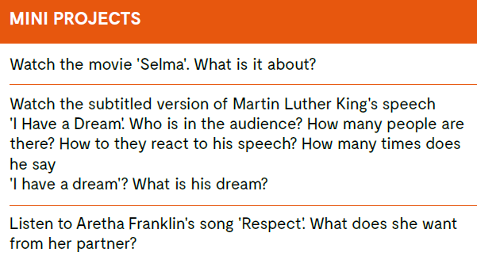
Choose one of the tasks:

Slide 5
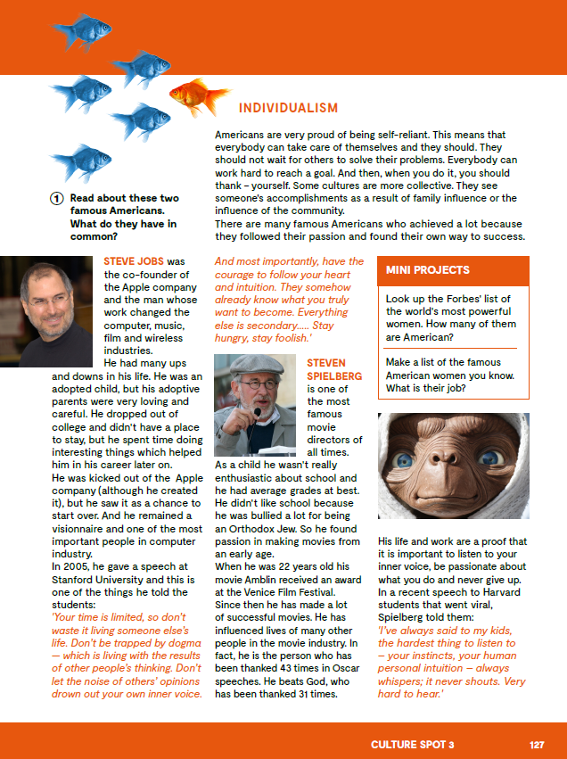
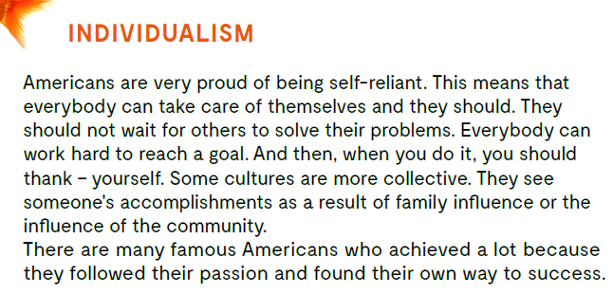

Slide 6
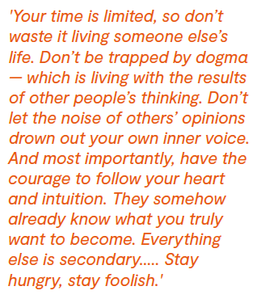
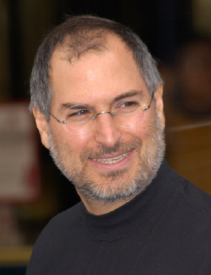
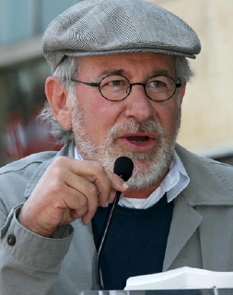
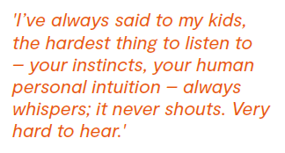


Who are these people? What do you know about them?
Who said this?

Slide 7
